Slide 1


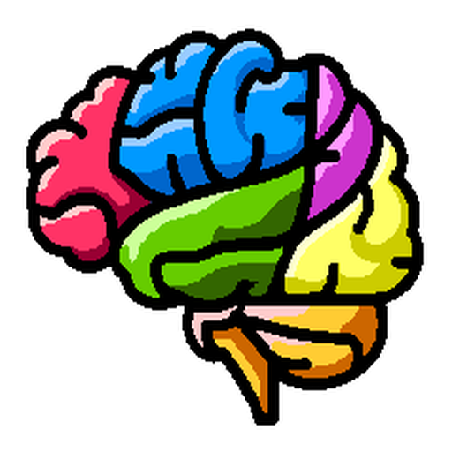
NiChart: Neuro Imaging Chart of AI-based Imaging Biomarkers
Statistical Methods in Imaging Conference (SMI) 2024
Notes:
As we already mentioned, the harmonization pipeline is integrated into the ‘NiChart’ project. Let’s now look deeper into the project itself.

Slide 2
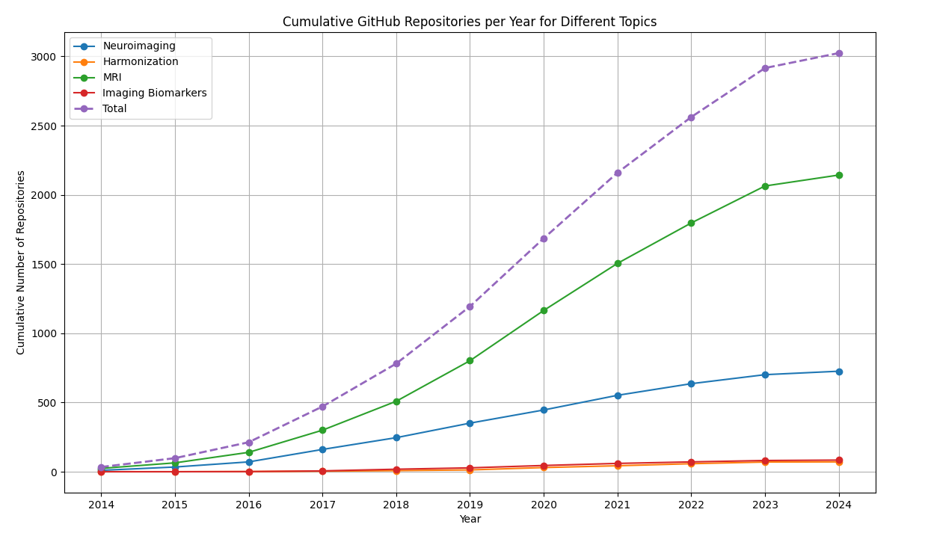
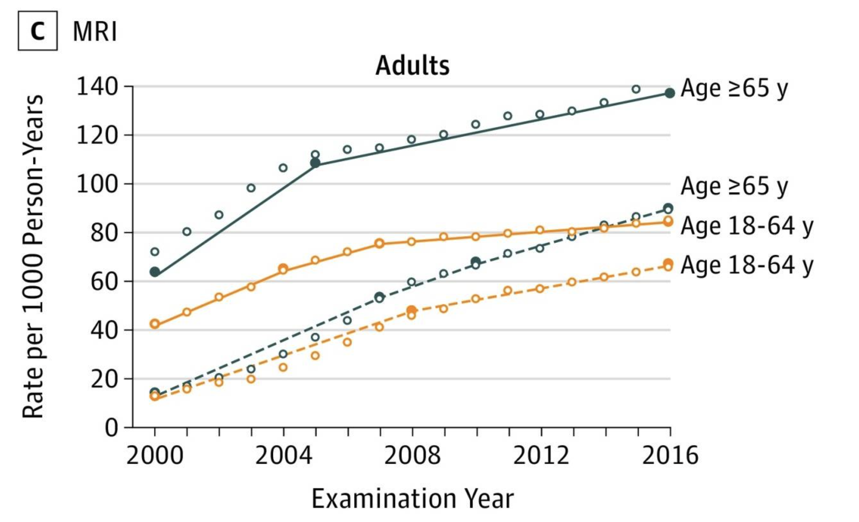
Smith-Bindman R, et al. Trends in Use of Medical Imaging, 2000-2016. JAMA. 2019;322(9):843-856. doi: 10.1001/jama.2019.11456.
Notes:
First, let’s begin by discussing the motivation behind this project. With the increasing volume of neuroimaging data, there is a corresponding rise in the development of computational tools designed to facilitate research and clinical analysis across various domains. Our objective is to streamline and improve these tools, enhancing their usability and efficiency.

Slide 3
Challenges for Researchers and Individual Clinicians in Neuroimaging field
Strategies to overcome the challenges
Collaborative Approach
User-friendly tools
Automation
On-demand computation
Six Major Challenges
Complexity
Understanding advanced techniques
Interpreting Results
Software and Tools
Learning curve
Integration and compatibility
Data Management
Handling large datasets
Data quality and preprocessing
Computational Resources
Access to High-Performance computing
Optimization and efficiency
Technical Support and Collaboration
Need for interdisciplinary collaboration
Technical support
Validation and Reproducibility
Ensuring validity
Reproducibility when using complex pipelines and scripts
Notes:
The growing volume of data and tools in neuroimaging presents significant challenges for researchers and clinicians. These challenges include the demand for greater computational resources, efficient data management, technical support, and ensuring validation and reproducibility of results. Moreover, new software tools often come with steep learning curves, high specialization, and require careful integration. NiChart addresses these challenges by providing a collaborative approach that integrates user-friendly tools with on-demand computation and automation.

Slide 4
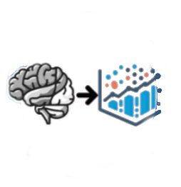
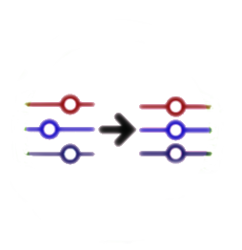
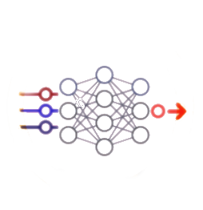
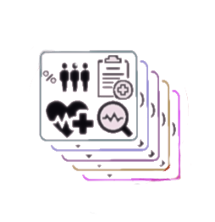
Process multi-modal MRI images
Harmonize to reference data
Apply ML models
Derive individualized biomarkers
“NiChart is an ecosystem of software components enabling constructive integration, statistical harmonization, and ML centric data analysis.”
Notes:
So what is NiChart?
NiChart is an ecosystem of software components enabling constructive integration, statistical harmonization, and ML centric data analysis.

Slide 5
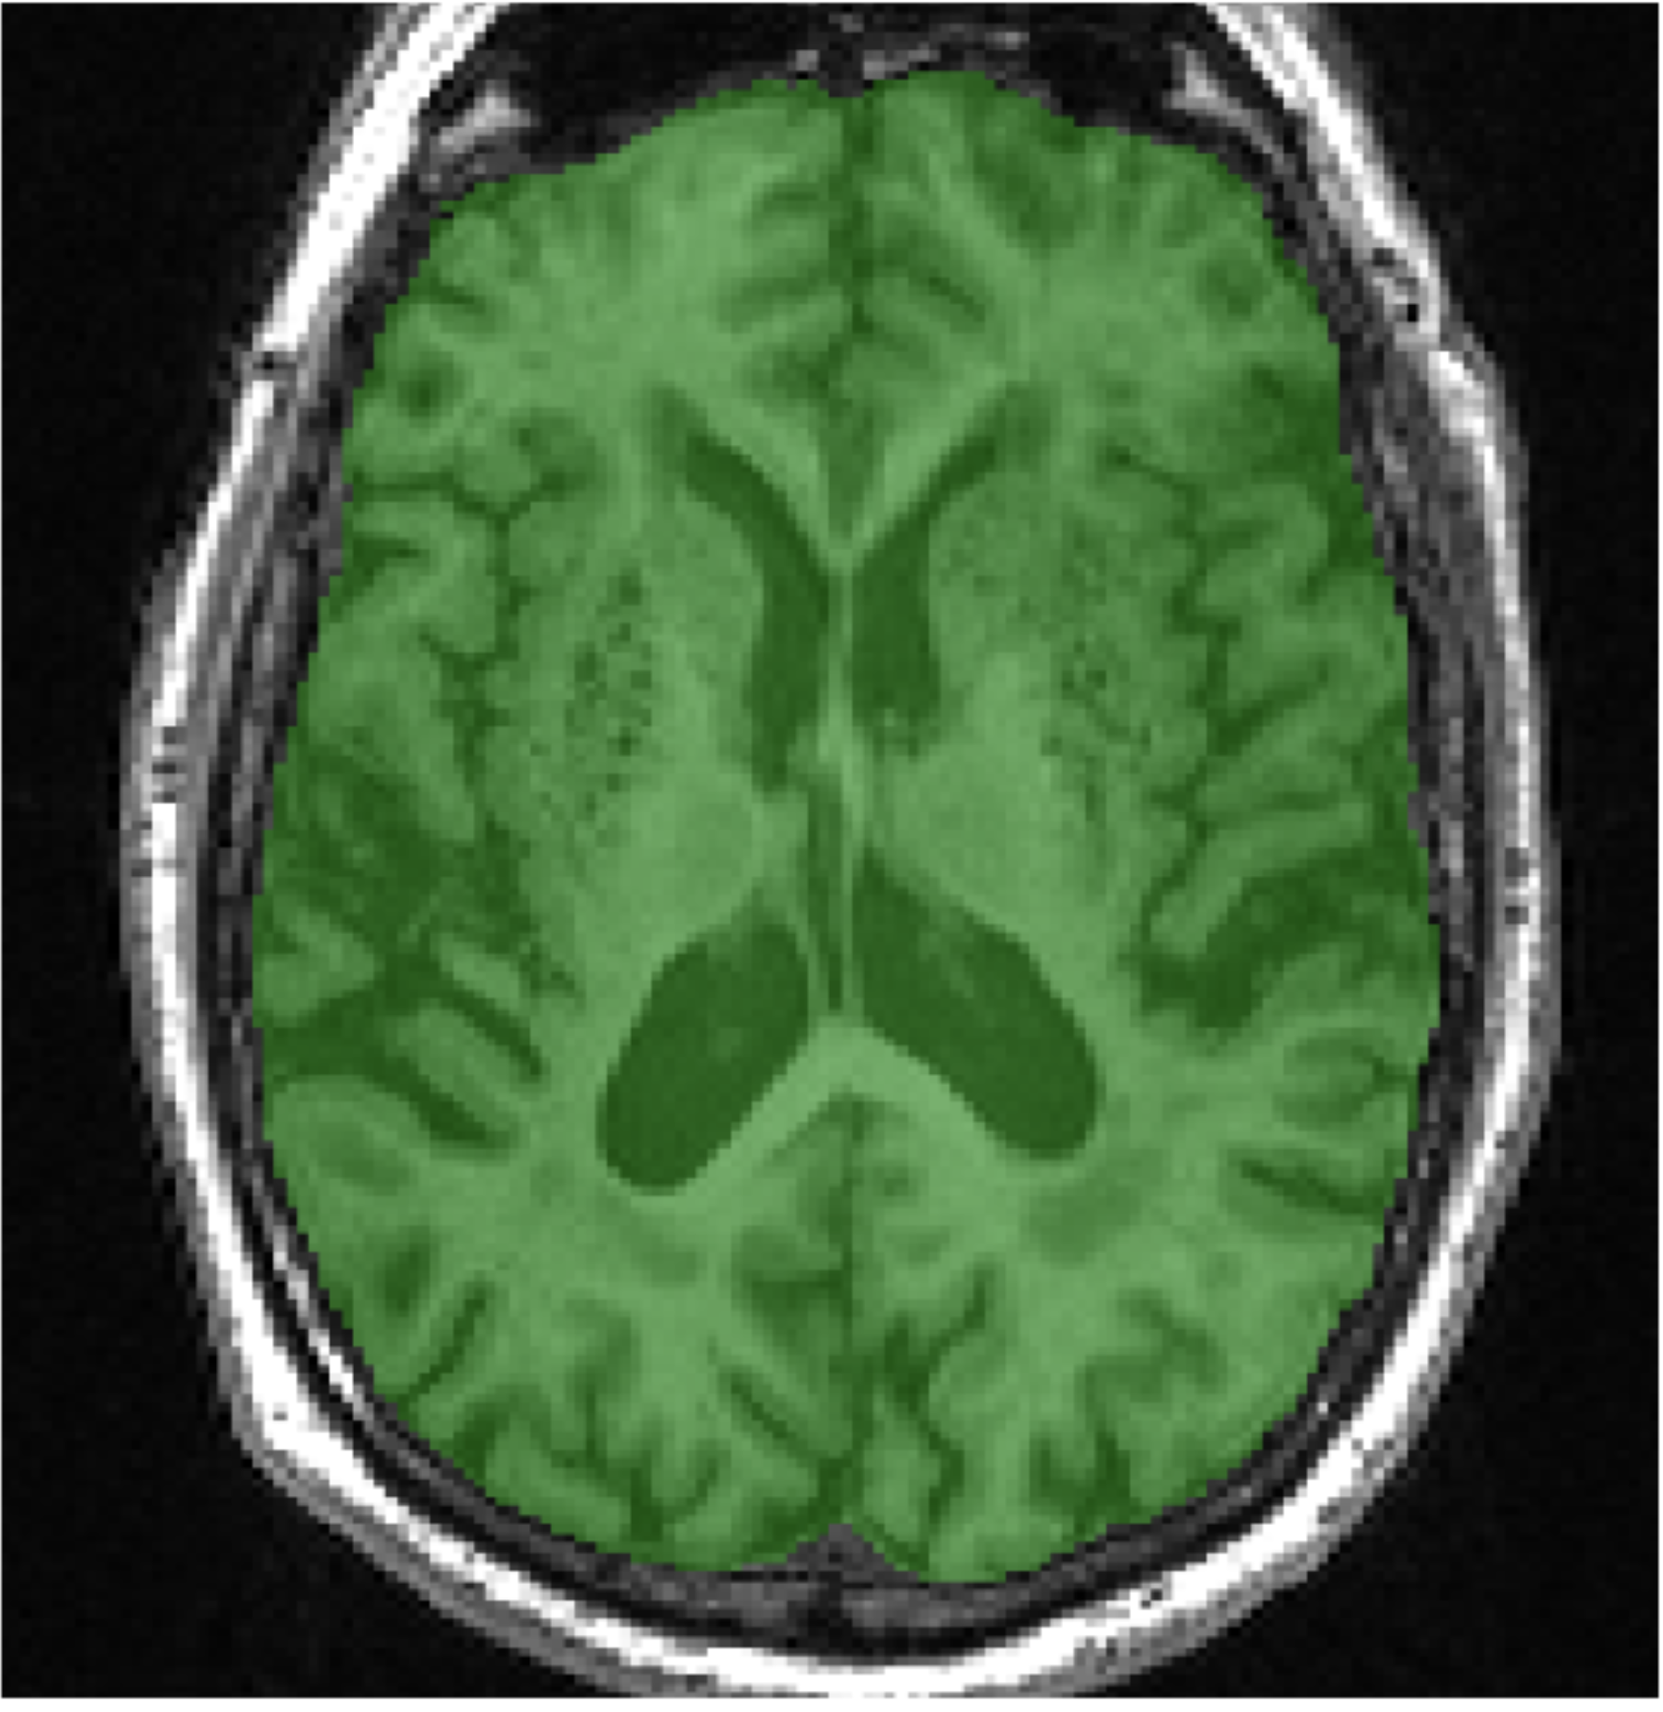
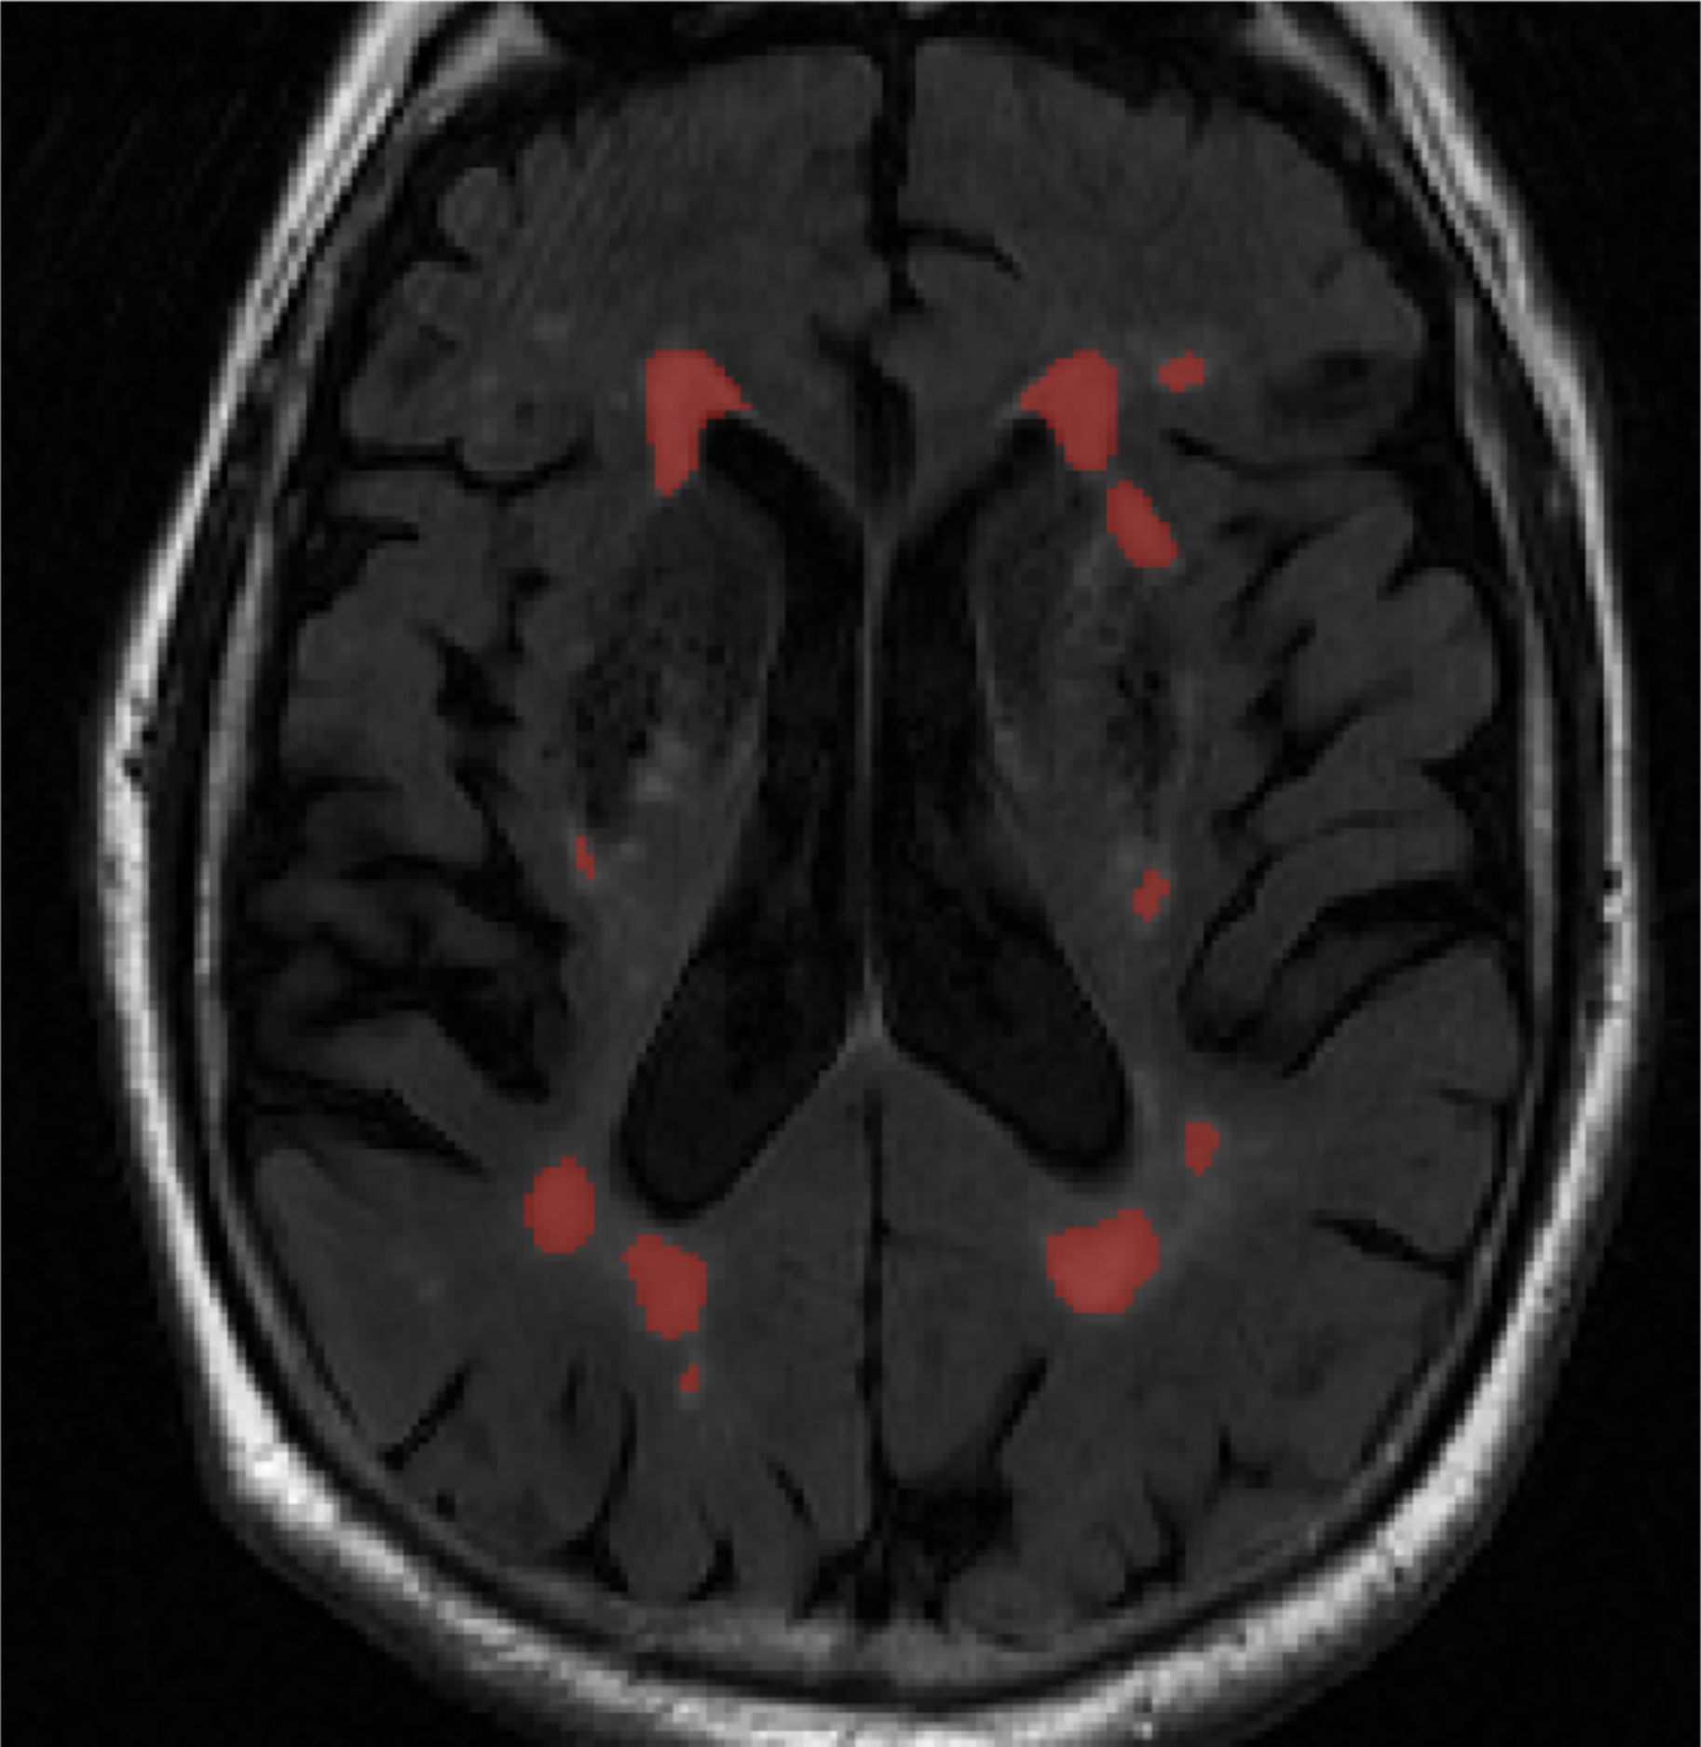
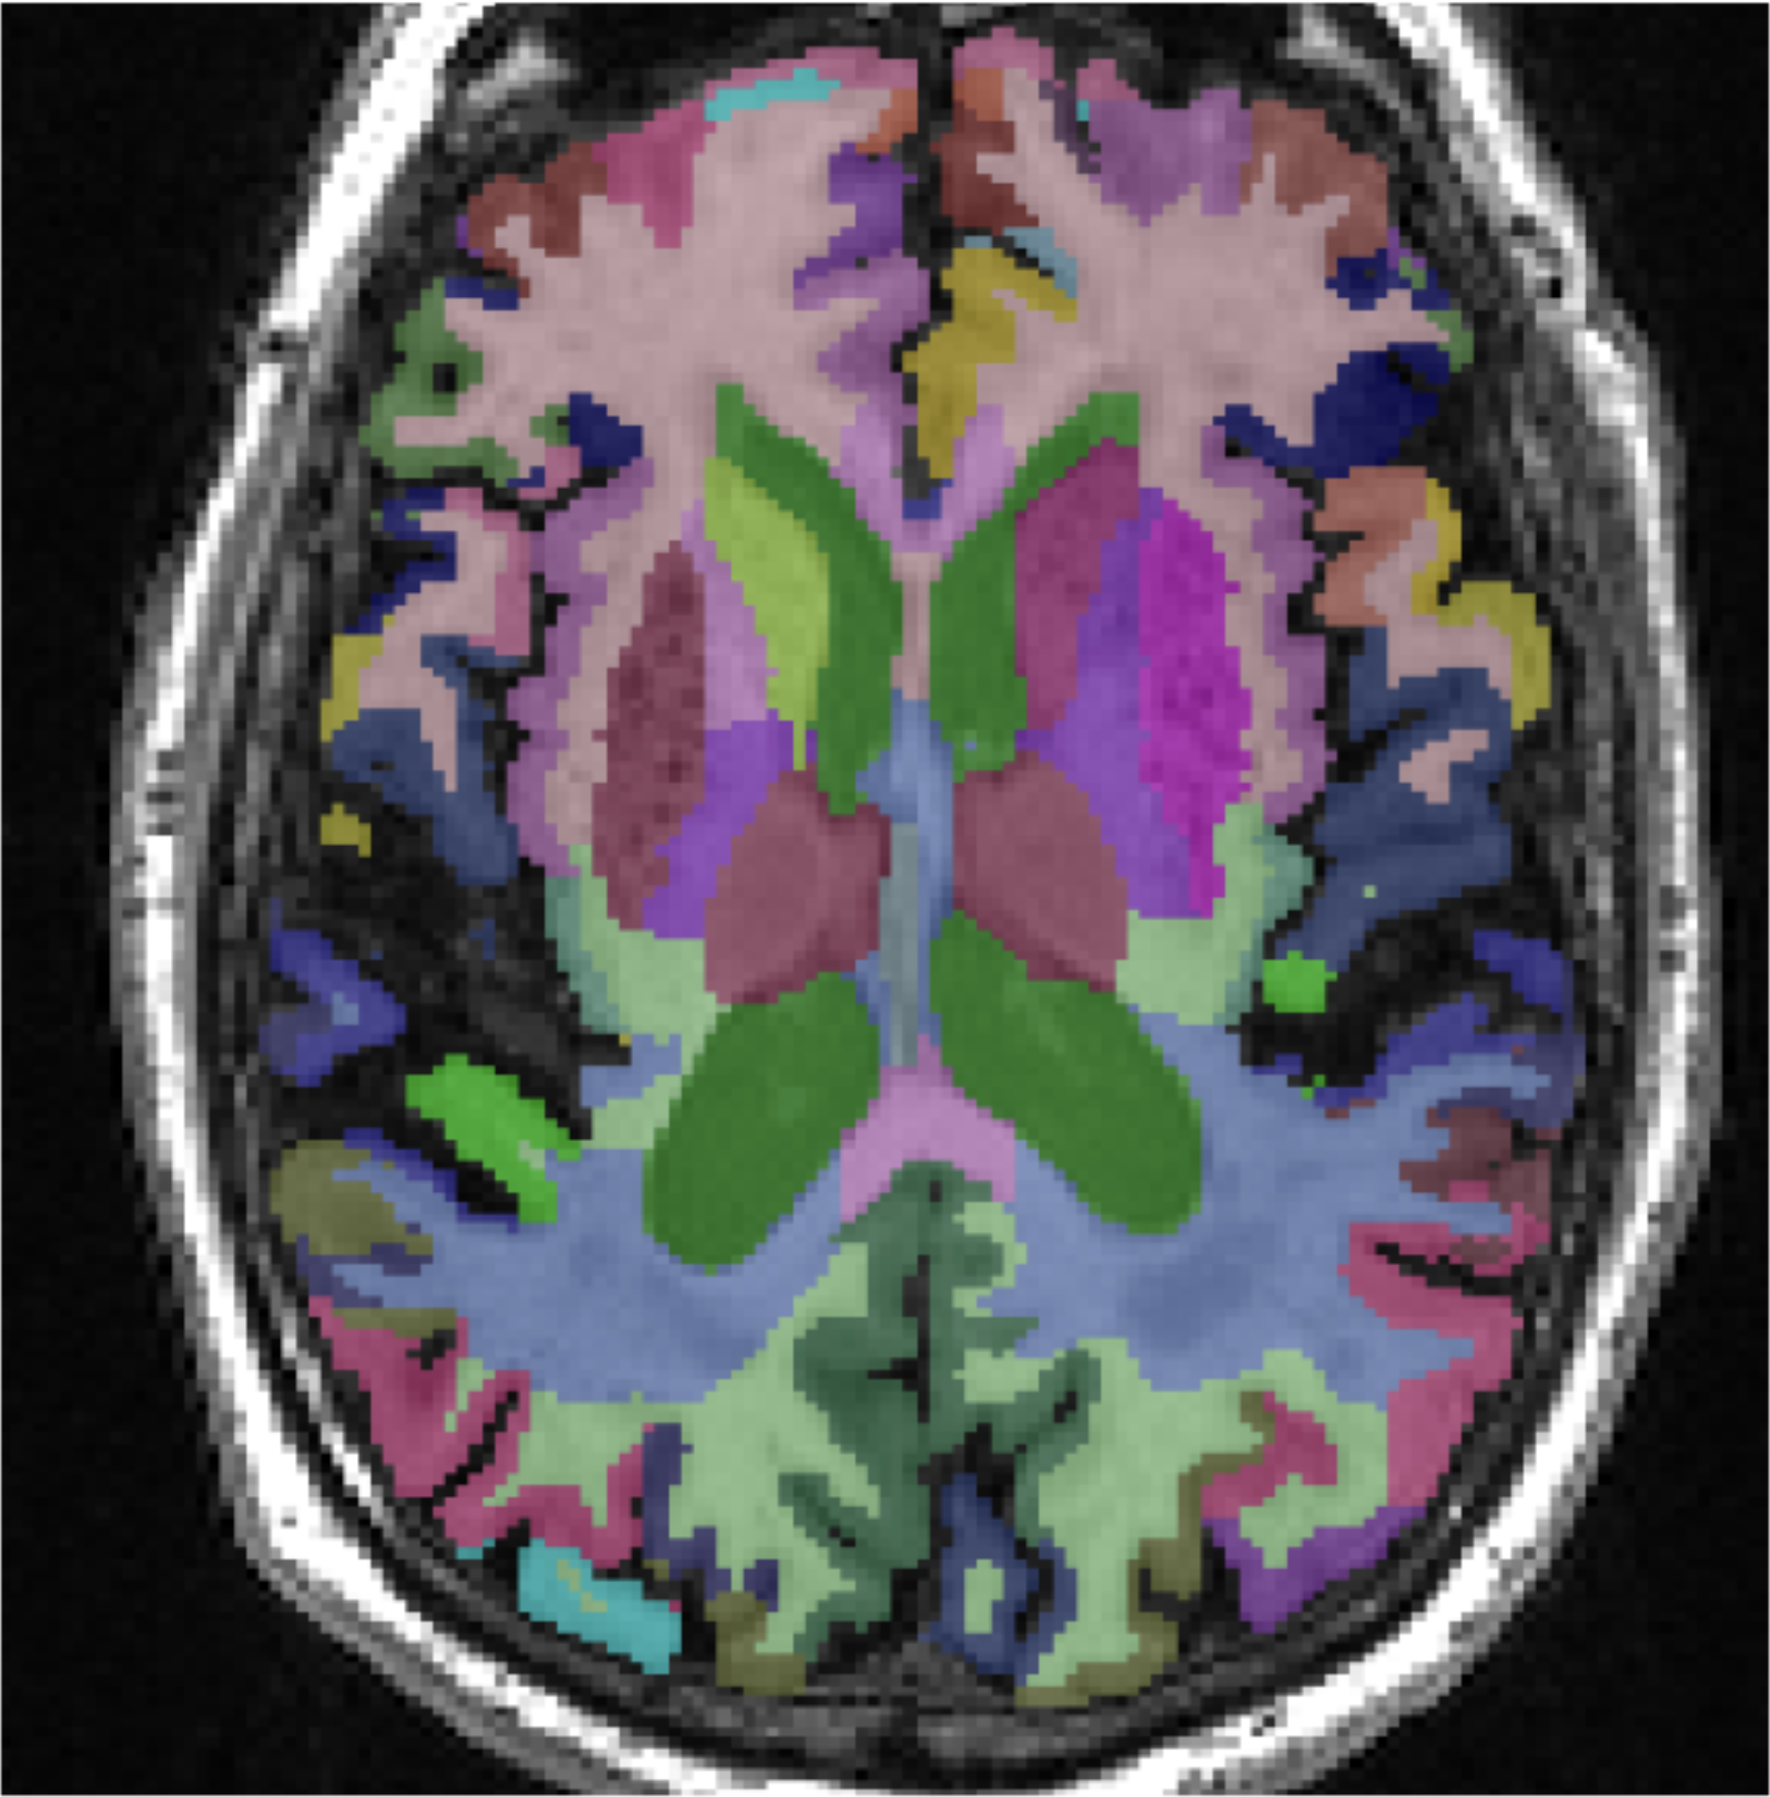
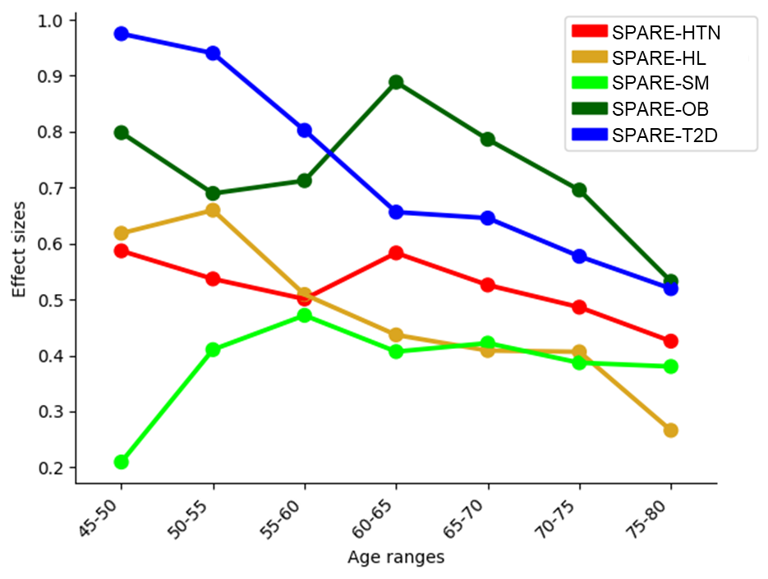
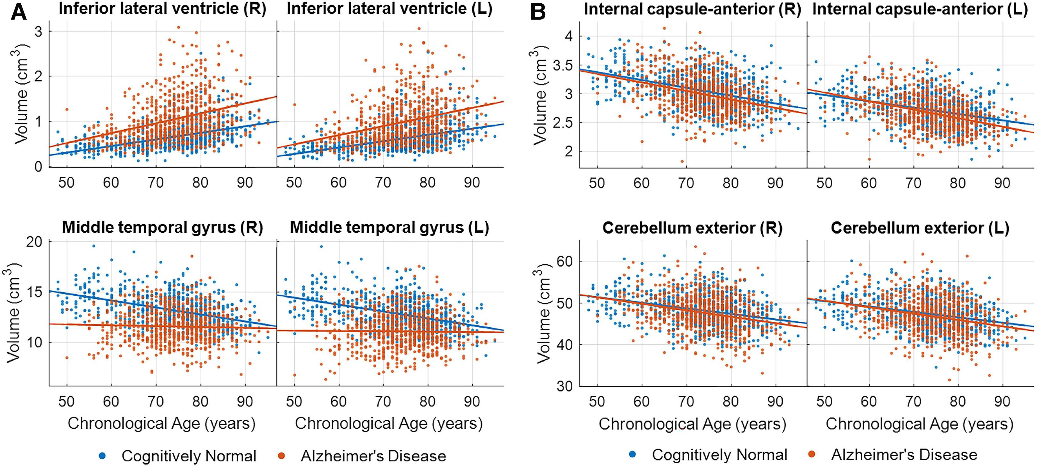
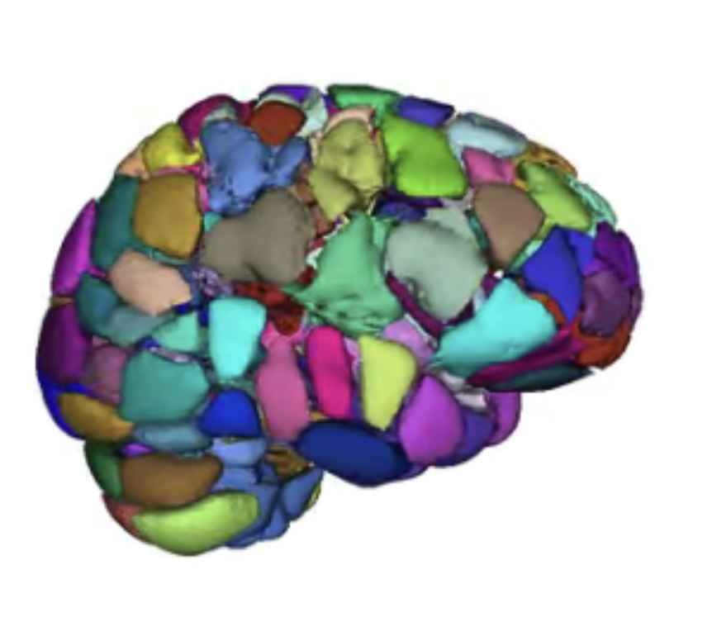
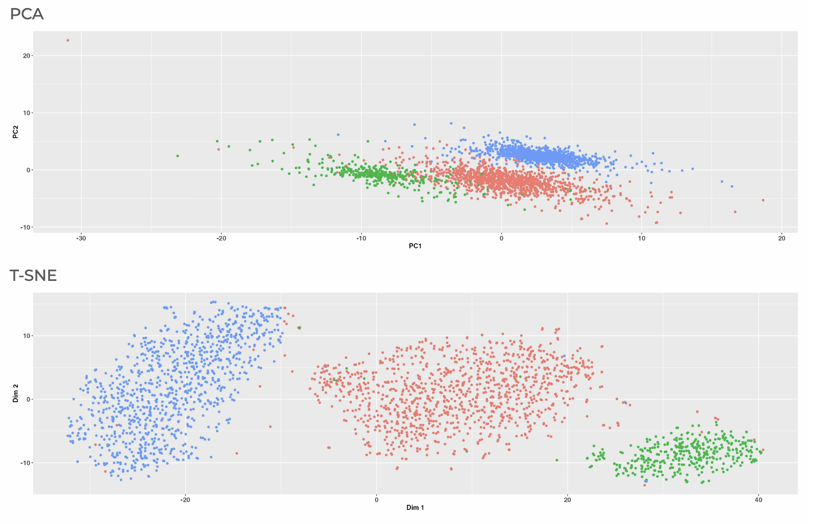
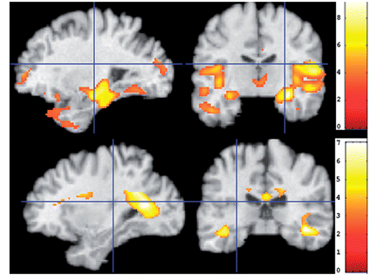
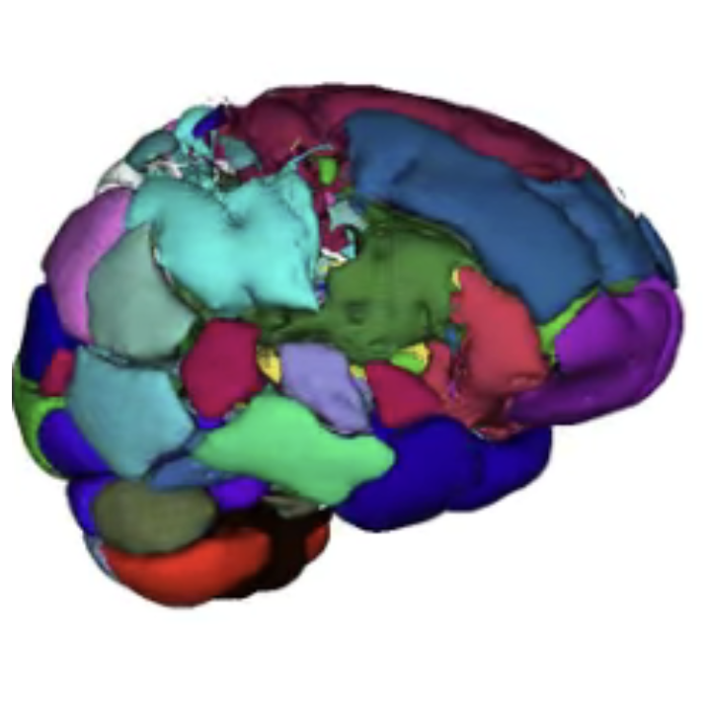
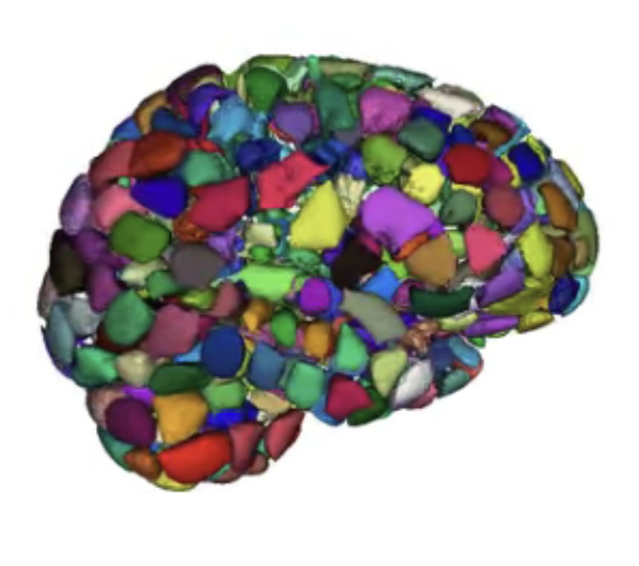
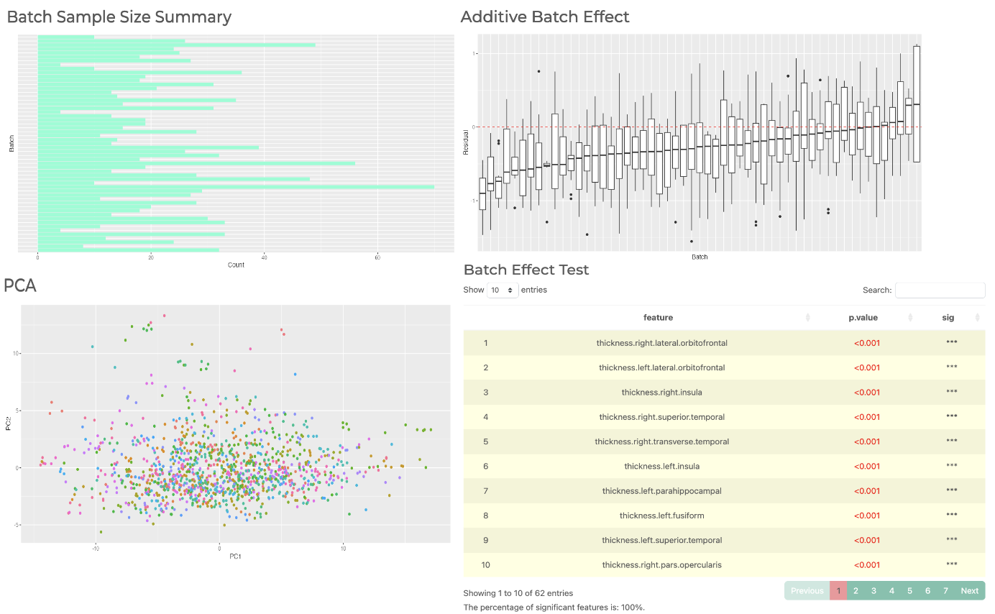
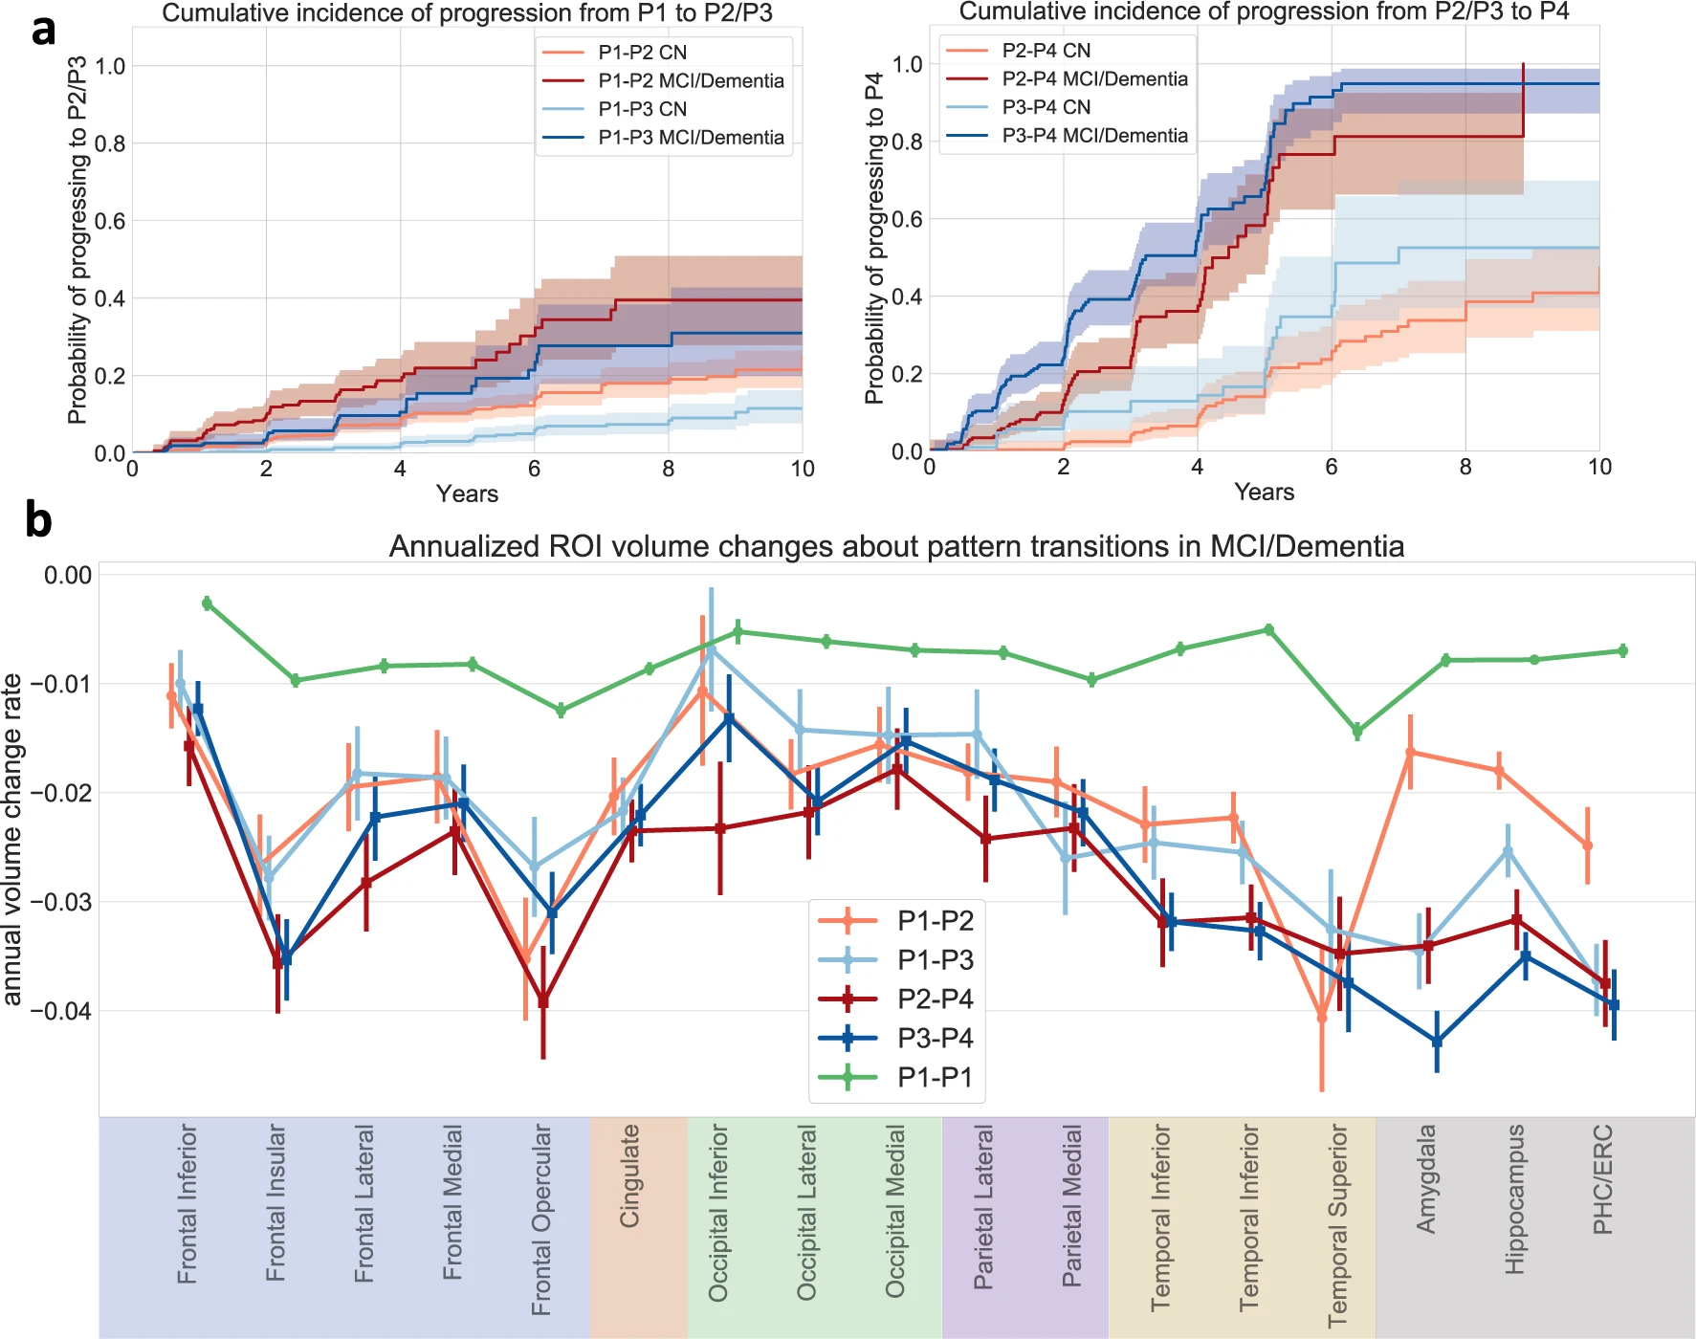
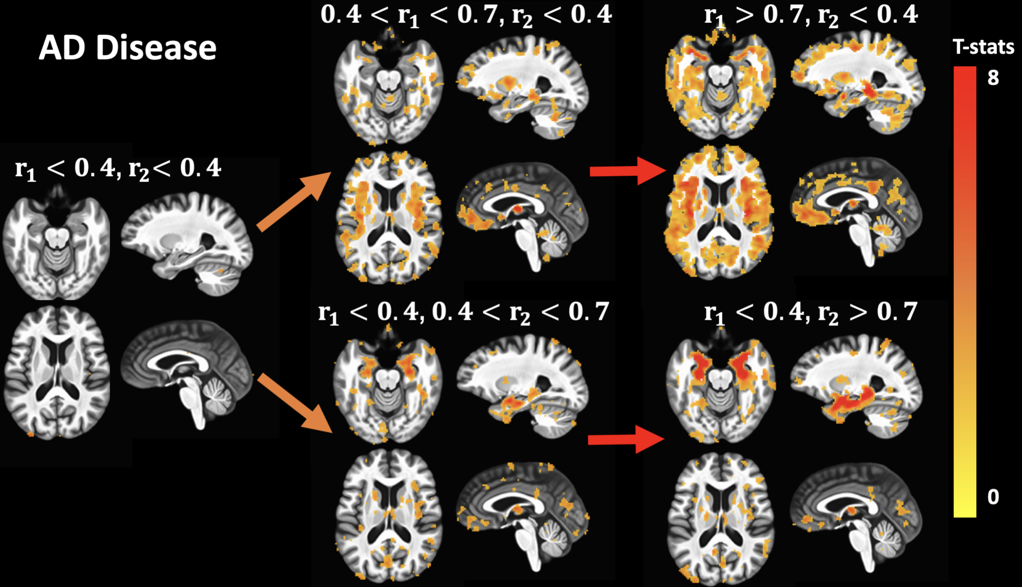
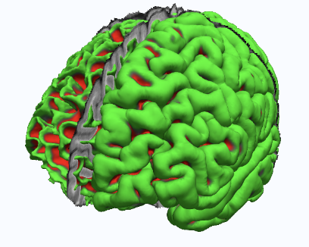
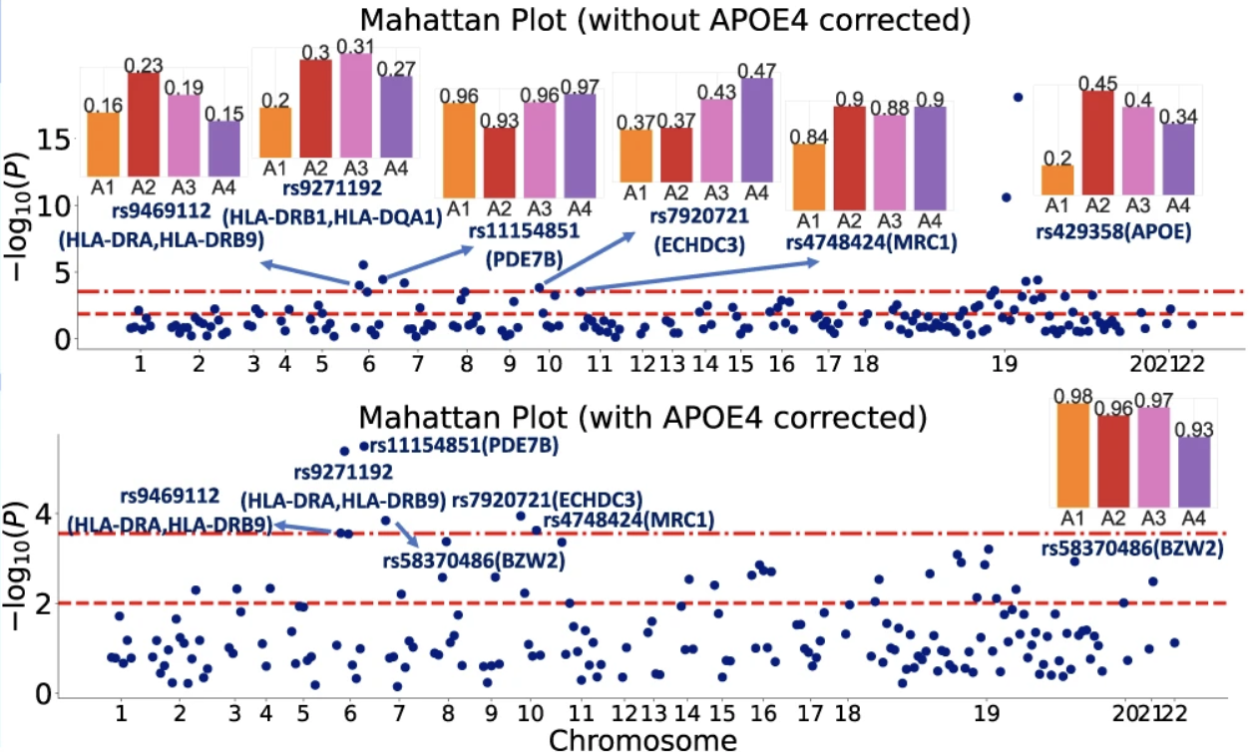
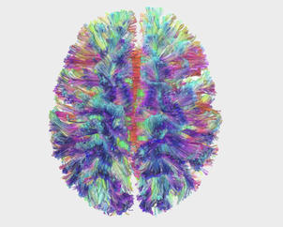
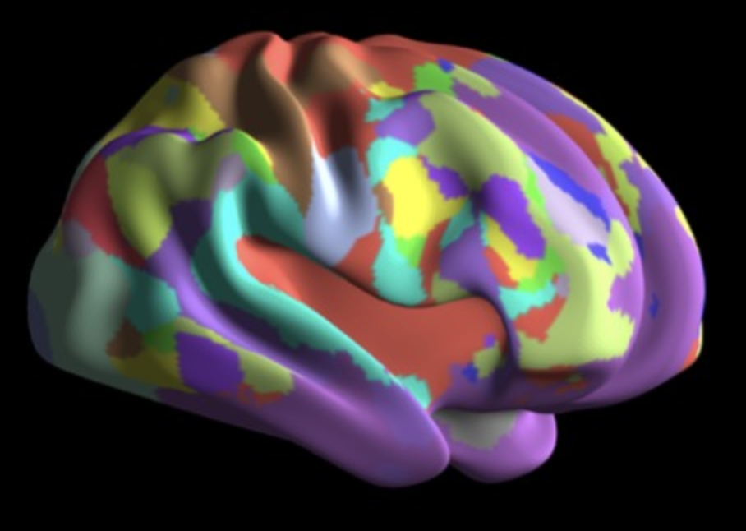
NiChart Software Components
NiChart Software Components
Image Processing
Data Harmonization
Machine Learning
Fast Segmentation of sMRI Anatomy and Abnormality
DLICV
Multi-Resolution Structural Covariance Patterns
sopNMF
End-to-end Processing Pipelines for fMRI and DTI Analysis
fMRIPrep
DLMUSE
DLWMLS
XCP-D
DTIPrep
pNet
Estimate and remove scanner-related batch effects in imaging variables:
ComBat
NiChart_Harmonize
Supervised ML models for age and disease prediction:
SPARE-AD
SPARE-BA
SPARE-CVM
Semi-supervised ML models for disease subtype analysis:
SmileGAN
SurrealGAN
Notes:
The main software components of NiChart are Image Processing, Data Harmonization, and Machine Learning.
First, in the Image processing step, we have software tools that perform
fast segmentation of sMRI Anatomy and Abnormality,
multi resolution structural covariance pattern extraction,
and end-to-end processing pipelines for fMRI and DTI analysis.
The processed images may then be harmonized as previously demonstrated to estimate and remove scanner-related batch effects in imaging variables as part of the Harmonization step.
Finally, in the Machine Learning step, we have supervised and semi-supervised tools to predict age and disease and perform disease subtype analysis.

Slide 6
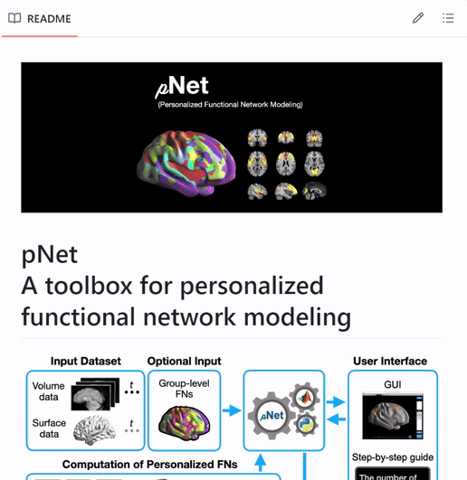
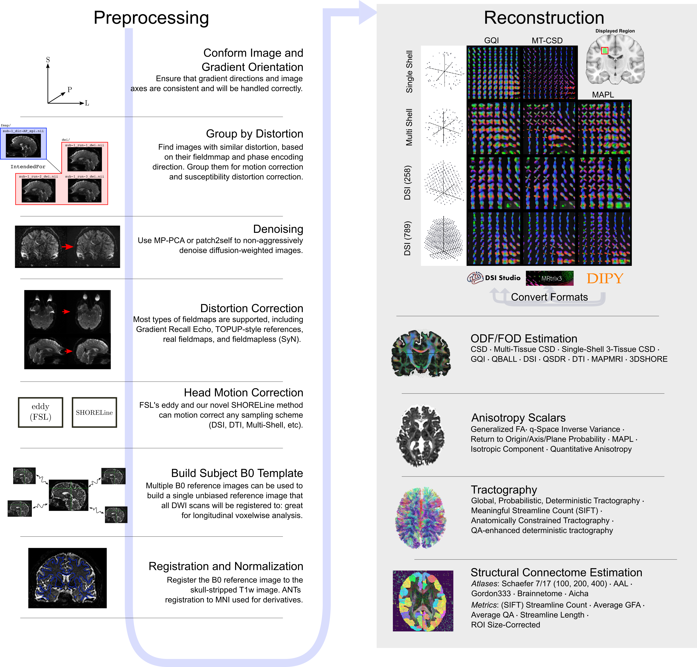
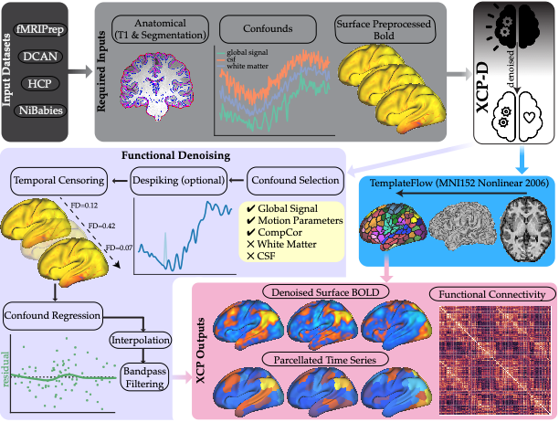
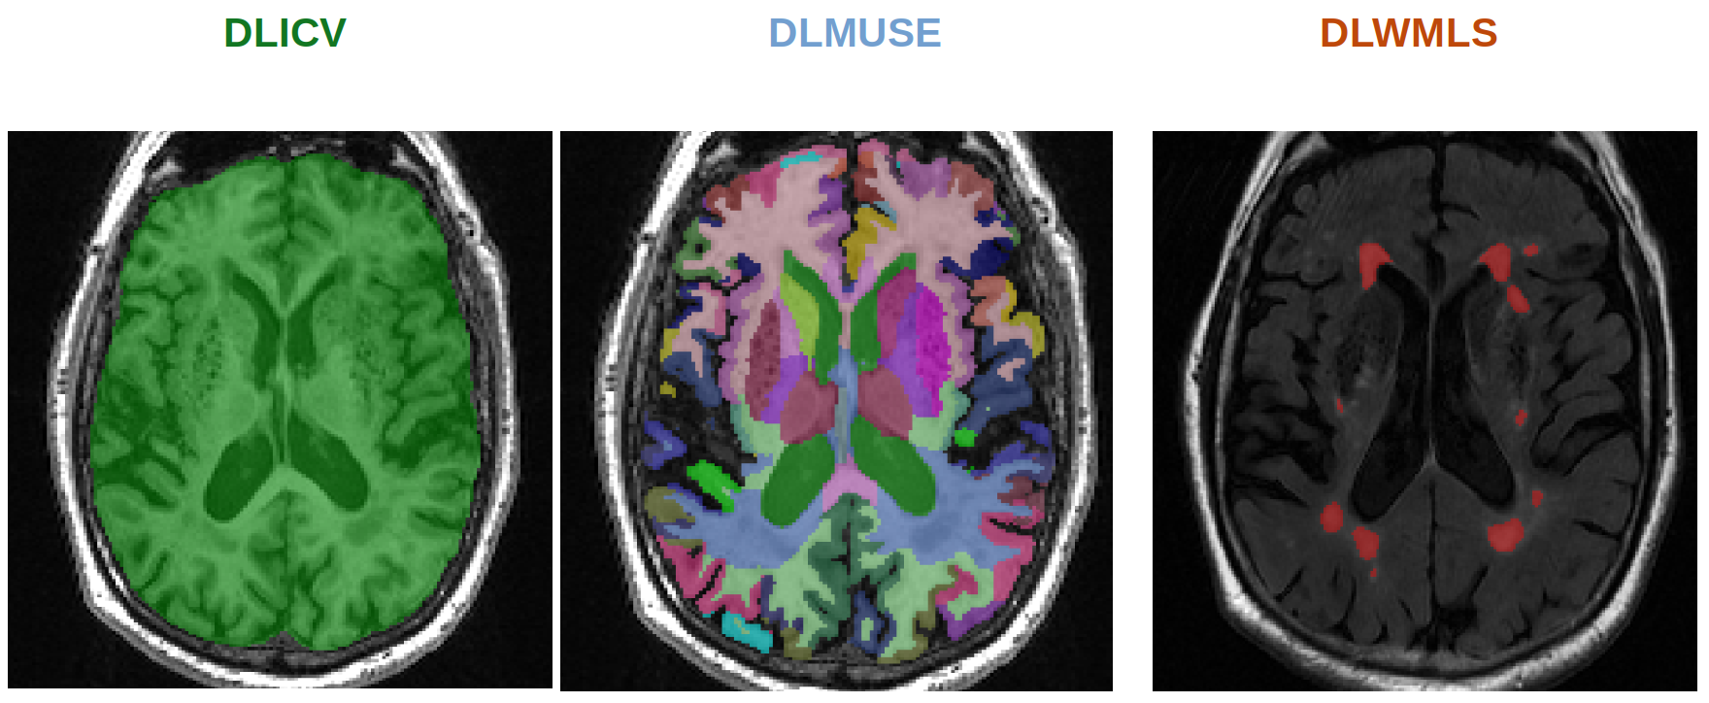
Image Processing
Image Processing
Deep Learning for fast segmentation of anatomy and abnormality for sMRI:
DLICV
DLMUSE
DLWMLS
Multi-resolution structural covariance patterns:
sopNMF
End-to-end processing pipelines for fMRI and DTI analysis:
fMRIPrep
XCP-D
DTIPrep
pNet
Preprocessing of diffusion MRI datasets using QSIPrep
Personalized Functional Network Modeling (pNet)
Multivariate structural analysis using sOPNMF
XCP-D flowchart
Example segmentation using DLICV, DLMUSE and DLWMLS
Notes:
Some of the Image Processing tools that we have so far developed are:
DLICV for performing Intra Cranial Volume extraction,
DLMUSE for MUlti-atlas region Segmentation,
and DLWMLS for White Matter Lesion Segmentation. All of these tools utilize fast, Deep Learning methods.
Additionally, using the sOPNMF tool, you can perform multi-resolution structural covariance pattern extraction.
Finally, under NiChart you can find end-to-end processing pipelines for fMRI and DTI analysis like fMRIPrep, XCP-D, DTIPrep and pNet. These tools enable:
the robust preprocessing of functional MRI data,
the modular processing of multimodal neuroimages with high-performance denoising and quality assessment,
the comprehensive preprocessing of diffusion MRI datasets ensuring data integrity and quality,
and personalized functional network computation and visualization.

Slide 7
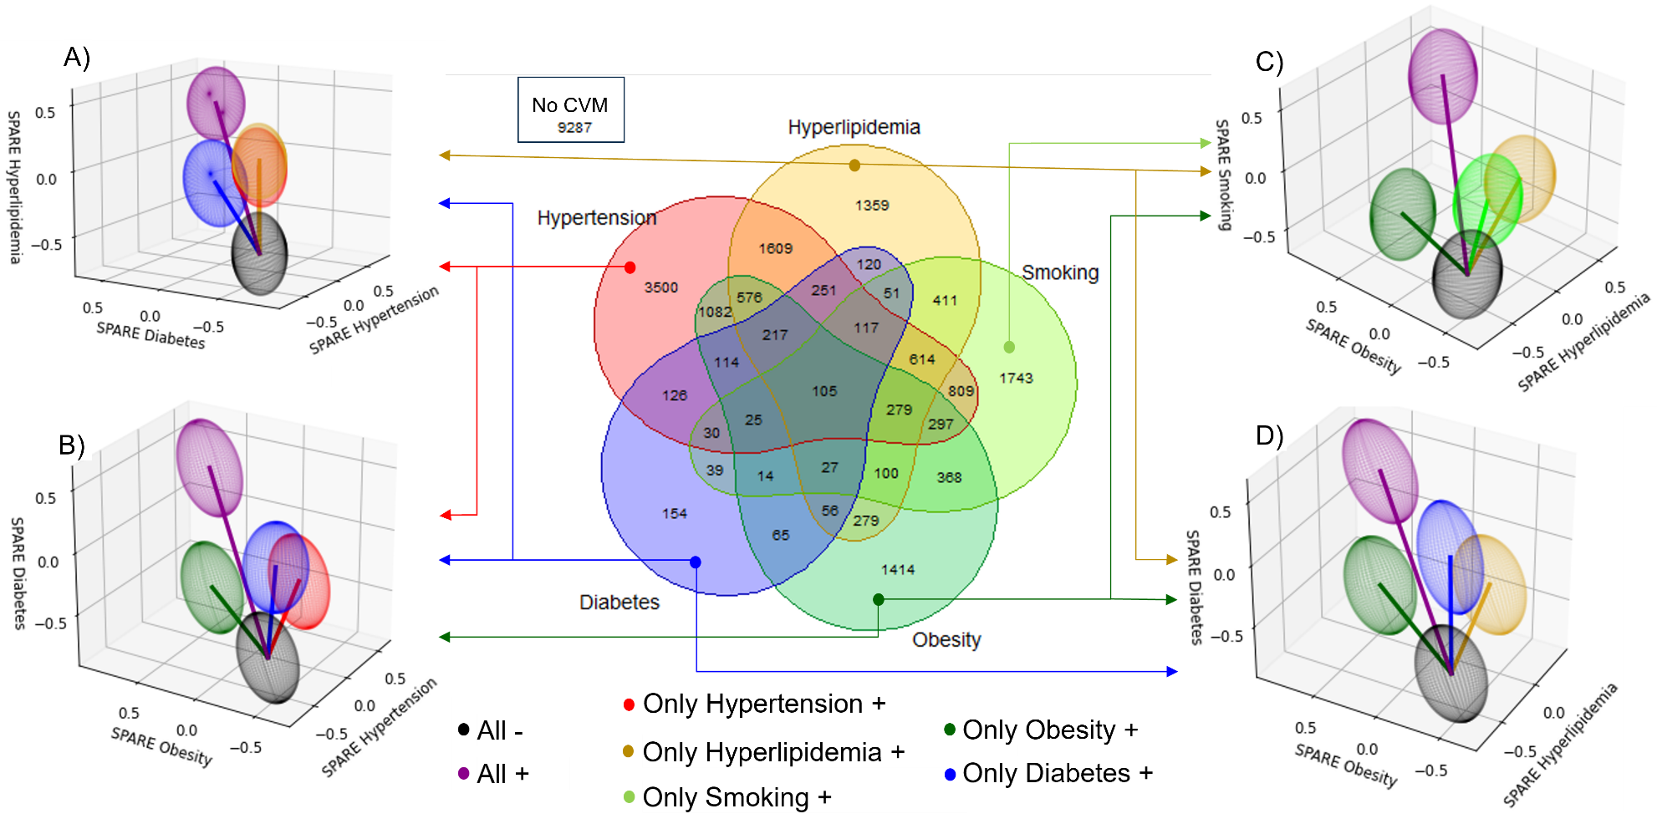
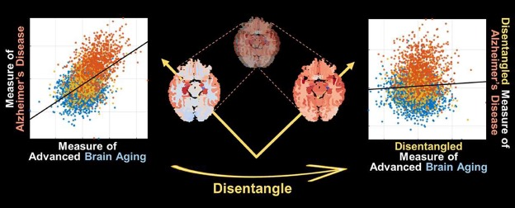
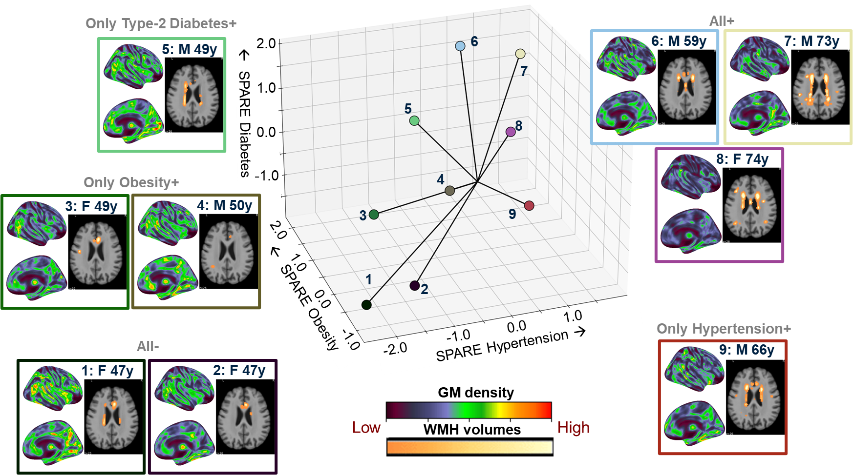
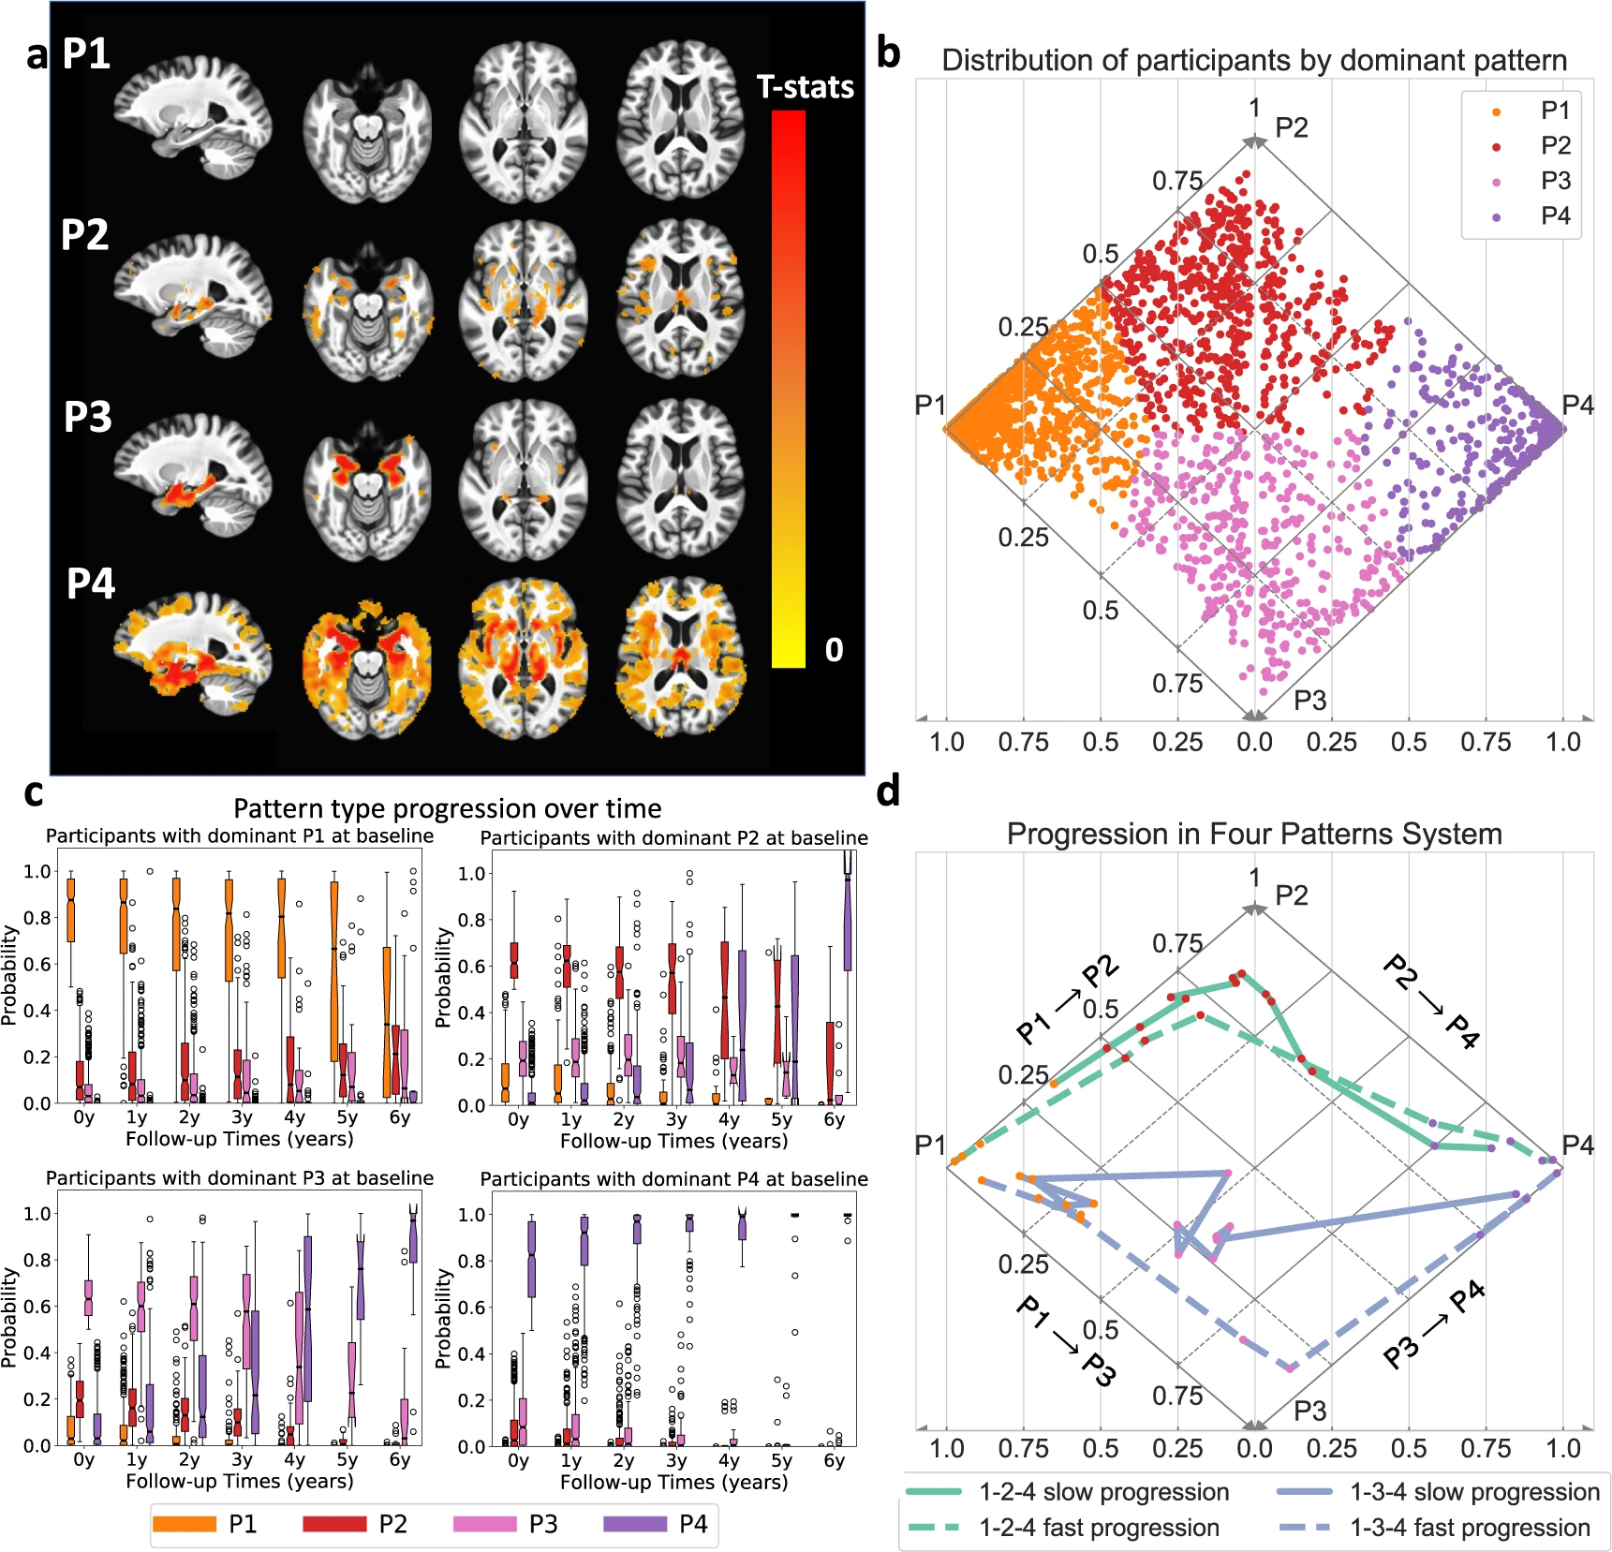
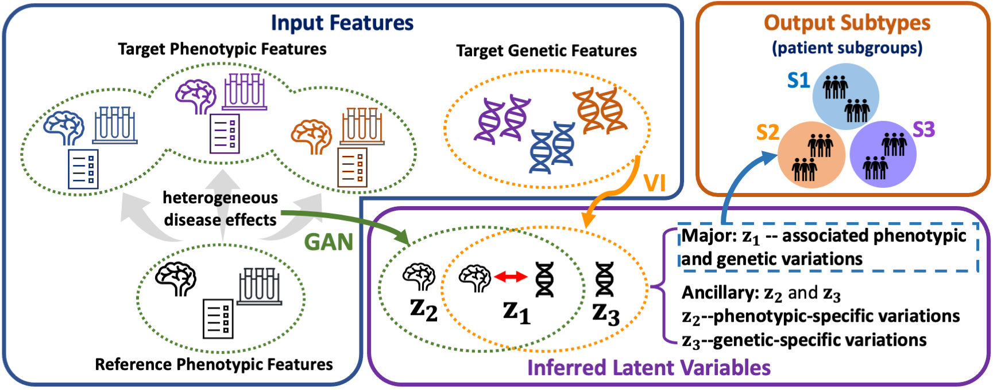
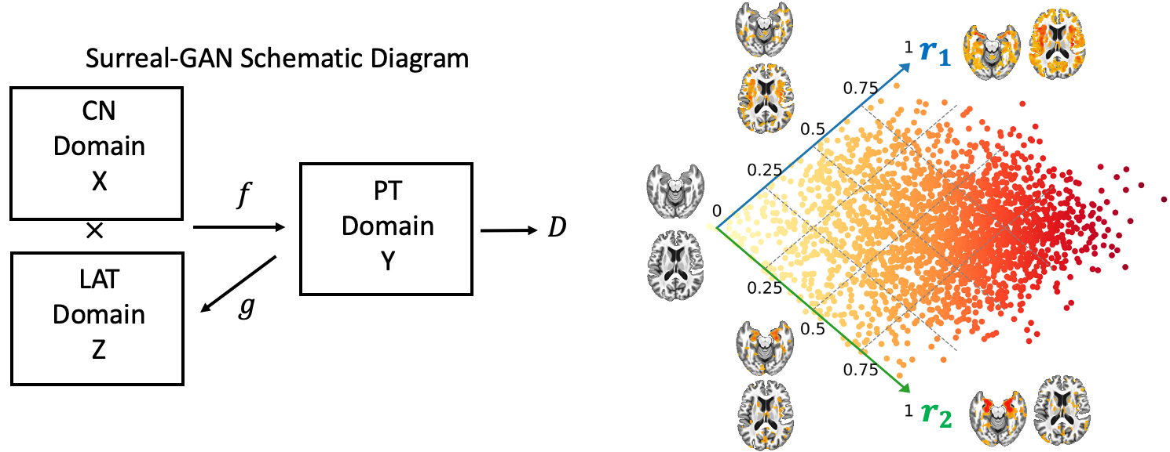
Machine Learning
Supervised ML models for age and disease prediction:
SPARE-AD
SPARE-BA
SPARE-CVM
Semi-supervised ML models for disease subtype analysis:
SmileGAN
SurrealGAN
GeneSGAN
Deep learning models for biomarker extraction from raw images:
DLSPARE
SPARE AD & BA: Graphical Abstract and examples of brain regions associated with typical ageing
SmileGAN: CVM Co-occurrence, SPARE-CVM dimensions Center and Individualized SPARE-CVMs
GeneSGAN: Schematic overview
SmileGAN: Neurodegeneration Atrophy Patterns
SurrealGAN: Schematic diagram
Notes:
Next, our machine learning component includes both supervised and semi-supervised models.
For example, SPARE-AD, SPARE-BA, and SPARE-CVM are supervised models used for predicting brain age and diseases. SPARE-AD focuses on detecting Alzheimer's disease-like patterns of brain atrophy with high accuracy, while SPARE-BA identifies advanced brain aging patterns and their association with risk factors like smoking and medication use. SPARE-CVM assesses cardiovascular and metabolic risks, offering detailed insights into how these factors impact brain structure and function.
Our semi-supervised models include SmileGAN, SurrealGAN, and Gene-SGAN, which are designed for disease subtype analysis. SmileGAN identifies disease-related heterogeneity by focusing on variations among patients, avoiding those in the control group. SurrealGAN models disease as a continuous process, learning transformation directions to capture specific imaging patterns and severities, providing a nuanced representation of disease progression. Gene-SGAN integrates brain phenotypic and genetic data to disentangle disease heterogeneity and identify subtypes with associated genetic signatures.
Additionally, DLSPARE is a deep learning model for extracting biomarkers from raw images, aiding in the analysis and interpretation of complex neuroimaging data.
These models collectively enhance our ability to understand, predict, and manage neurological conditions through sophisticated machine learning techniques.

Slide 8
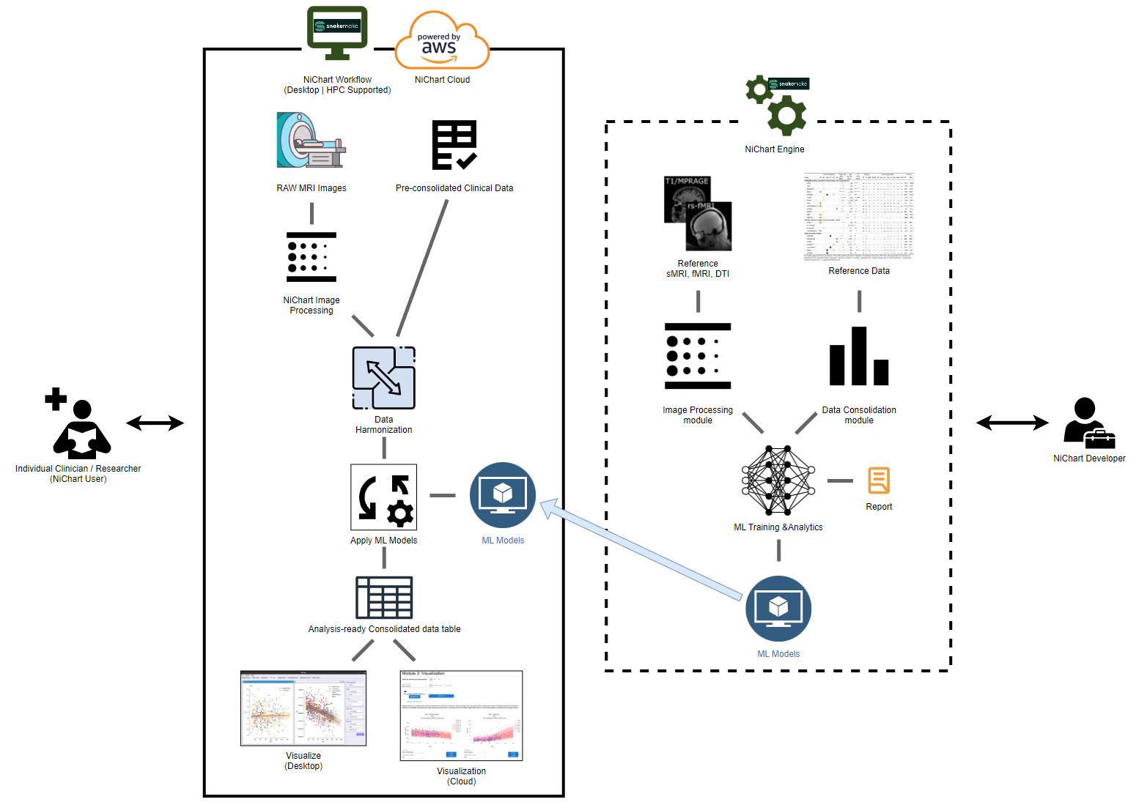
NiChart Framework Architecture
Notes:
This diagram illustrates the NiChart framework architecture from both the user and developer perspectives. Users, including clinicians and researchers, input raw MRI images and clinical data into the NiChart workflows. The workflows, either locally or on the cloud, process and harmonize the data, applying machine learning models to derive individualized biomarkers. The results are then consolidated into an analysis-ready data table, which can be visualized through desktop or cloud-based tools.
On the developer side, the NiChart Engine includes essential modules for image processing, data consolidation, and machine learning. Developers continuously refine these components to ensure seamless integration and optimal performance. The framework supports deployment via Docker and Singularity containers and is accessible on AWS and GitHub.

Slide 9
Deployment
Docker & Singularity Containers
AWS – NiChart Cloud Application
https://github.com/CBICA/NiChart_Project
https://hub.docker.com/u/cbica
https://neuroimagingchart.com/
Open-source Packages on GitHub
Notes:
The NiChart framework is designed to be modular, scalable, and collaborative. It supports deployment through Docker and Singularity containers and is accessible via AWS as a cloud application. Our project is fully open-source, with packages available on GitHub, containers on Dockerhub, and a free-to-use cloud application for testing, running, and utilizing implemented pipelines. We encourage community contributions and have published detailed guides on conforming your models and pipelines to the NiChart standard. If you are interested in contributing to NiChart, please get in touch with us. We are eager to collaborate and integrate new tools and models that can enhance our framework.

Slide 10
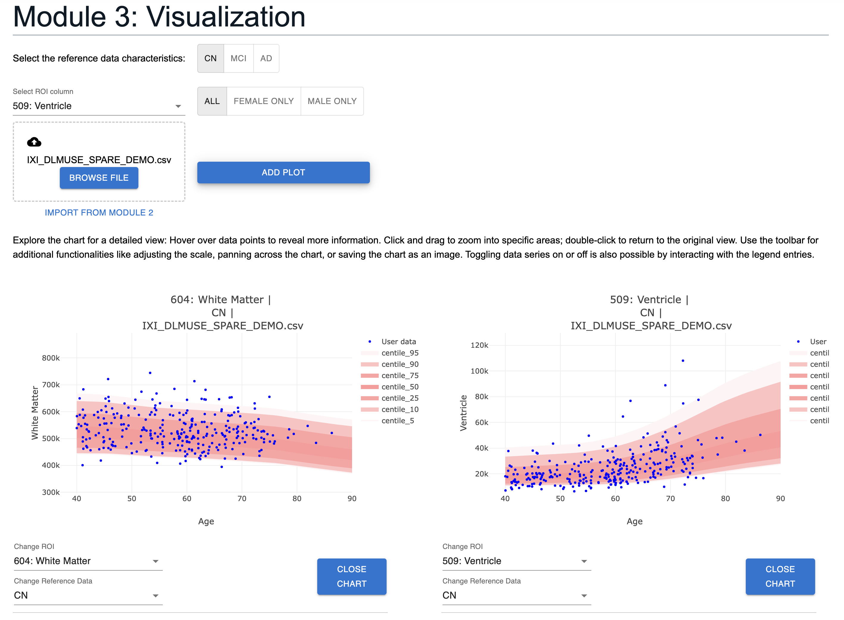
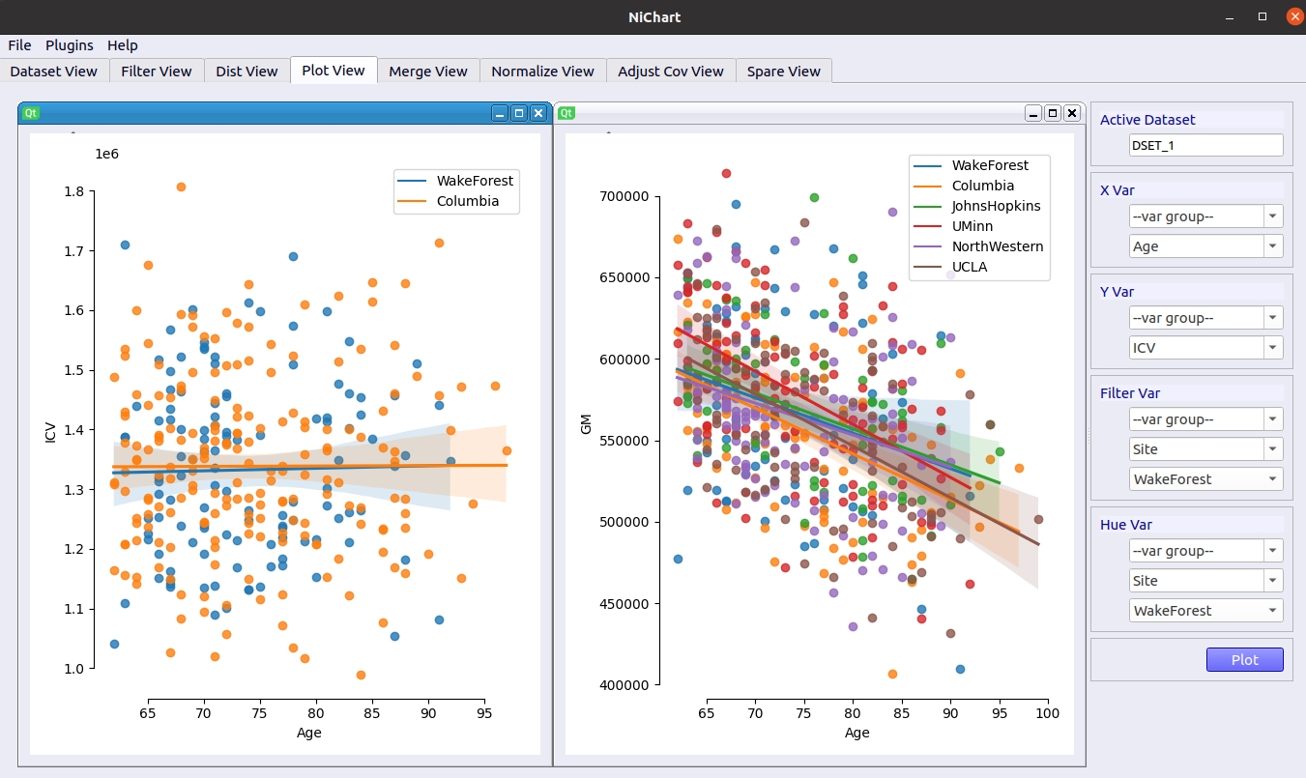
Visualization
PyQT based tool for data visualization:
JavaScript based client-side tool for data visualization on the web:
Notes:
Additionally, we offer visualization tools to aid in data analysis. These include a locally installable PyQT-based tool and a JavaScript-based web application tool, running on AWS. These tools are designed to provide intuitive and interactive visualizations of complex neuroimaging data.

Slide 11
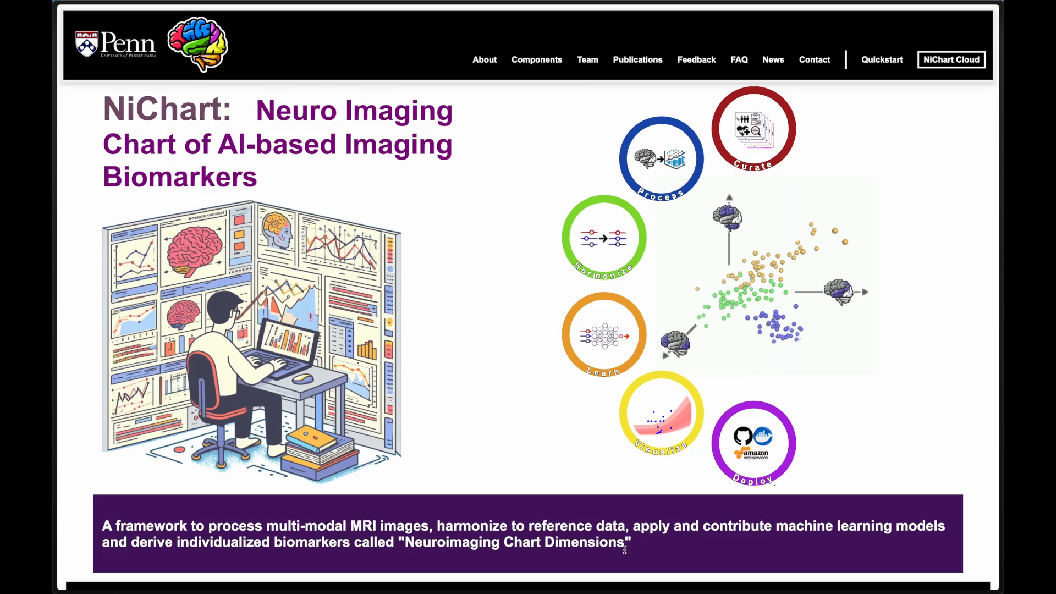
Demo – NiChart Web Portal
Notes:
Let’s now look at a demo of the NiChart Cloud application on AWS and its capabilities.

Slide 12

Participating Labs & Contributors
Artificial Intelligence in Biomedical Imaging Laboratory (AIBIL) ﻿﻿
Lifespan Informatics & Neuroimaging Center (LINC) ﻿﻿
Machine Learning for Biomedical Data Analysis (MLBD) ﻿﻿
Penn Statistics in Imaging and Visualization Endeavor (PennSIVE)
Christos Davatzikos, AIBIL
Russell Shinohara, PennSIVE
Guray Erus, AIBIL
Haochang Shou, PennSIVE
Alexander Getka, AIBIL
Ren Zheng, PennSIVE
George Aidinis, AIBIL
Di Wu, AIBIL
Kyunglok (Kyle) Baik, AIBIL
Yuhan Cui, AIBIL
Dhivya Srinivasan, AIBIL
Mark Bergman, AIBIL
Ilya Nasrallah, AIBIL
Fan Yong, MLBD
Hongming Li, MLBD
Yuncong Ma, MLBD
Theodore Satterthwaite, LINC
Matthew Cieslak, LINC
Taylor Salo, LINC
Daniel Wolf, Penn Psychiatry
Notes:
Our work is supported by several labs and contributors, including AIBIL, LINC, MLBD, and PennSIVE.

Slide 13
Our work
Doshi J, Erus G, Ou Y, et al. MUSE: MUlti-atlas region Segmentation utilizing Ensembles of registration algorithms and parameters, and locally optimal atlas selection. NeuroImage. 2016;127:186–195.
Cieslak, M., Cook, P.A., He, X. et al. QSIPrep: an integrative platform for preprocessing and reconstructing diffusion MRI data. Nature Methods 18, 775–778 (2021).
Esteban, O., Markiewicz, C.J., Blair, R.W. et al. fMRIPrep: a robust preprocessing pipeline for functional MRI. Nature Methods 16, 111–116 (2019).
Mehta K, Salo T, Madison T, Adebimpe A, Bassett DS, Bertolero M, Cieslak M, Covitz S, Houghton A, Keller AS, Luo A, Miranda-Dominguez O, Nelson SM, Shafiei G, Shanmugan S, Shinohara RT, Sydnor VJ, Feczko E, Fair DA, Satterthwaite TD. XCP-D: A Robust Pipeline for the post-processing of fMRI data. bioRxiv
Da X, Toledo JB, Zee J, et al. Integration and relative value of biomarkers for prediction of MCI to AD progression: Spatial patterns of brain atrophy, cognitive scores, APOE genotype and CSF biomarkers. NeuroImage Clin. 2014;4(0):164–173.
Davatzikos C, Xu F, An Y, Fan Y, Resnick SM. Longitudinal progression of Alzheimer’s-like patterns of atrophy in normal older adults: the SPARE-AD index. Brain. 2009;132(8):2026–2035.
Bashyam VM, et al. MRI signatures of brain age and disease over the lifespan based on a deep brain network and 14 468 individuals worldwide. Brain. 2020 Jul 1;143(7):2312-2324.
Wen, J. et al. Characterizing Heterogeneity in Neuroimaging, Cognition, Clinical Symptoms, and Genetics Among Patients With Late-Life Depression. JAMA Psychiatry 79, 464-474 (2022).
Yang, Z. et al. A deep learning framework identifies dimensional representations of Alzheimer’s Disease from brain structure. Nature Communications 12 (2021).
Yang, Z., Wen, J., Abdulkadir, A. et al. Gene-SGAN: discovering disease subtypes with imaging and genetic signatures via multi-view weakly-supervised deep clustering. Nature Communications 15, 354 (2024).
Fortin, J.-P., Cullen, N., Sheline, Y. I., Taylor, W. D., Aselcioglu, I., Cook, P. A., Adams, P., Cooper, C., Fava, M., McGrath, P. J., McInnis, M., Phillips, M. L., Trivedi, M. H., Weissman, M. M., & Shinohara, R. T. (2018). Harmonization of cortical thickness measurements across scanners and sites. NeuroImage, 167, 104–120.
Fortin, J.-P., Parker, D., Tunç, B., Watanabe, T., Elliott, M. A., Ruparel, K., Roalf, D. R., Satterthwaite, T. D., Gur, R. C., Gur, R. E., Schultz, R. T., Verma, R., & Shinohara, R. T. (2017). Harmonization of multi-site diffusion tensor imaging data. NeuroImage, 161, 149–170.
Johnson, W. E., Li, C., & Rabinovic, A. (2007). Adjusting batch effects in microarray expression data using empirical Bayes methods. Biostatistics, 8(1), 118–127.
Chen, A. A., Beer, J. C., Tustison, N. J., Cook, P. A., Shinohara, R. T., Shou, H., & Initiative, T. A. D. N. (2022). Mitigating site effects in covariance for machine learning in neuroimaging data. Human Brain Mapping, 43(4), 1179–1195.
Beer, J. C., Tustison, N. J., Cook, P. A., Davatzikos, C., Sheline, Y. I., Shinohara, R. T., & Linn, K. A. (2020). Longitudinal ComBat: A method for harmonizing longitudinal multi-scanner imaging data. NeuroImage, 220, 117129.
Pomponio, R., Shou, H., Davatzikos, C., et al., (2020). "Harmonization of large MRI datasets for the analysis of brain imaging patterns throughout the lifespan." NeuroImage 208.
Notes:
Here is a list of our key publications, which provide detailed insights and validation of the methods and tools integrated into NiChart. These references offer further reading for those interested in the technical and scientific foundations of our work.

Slide 14
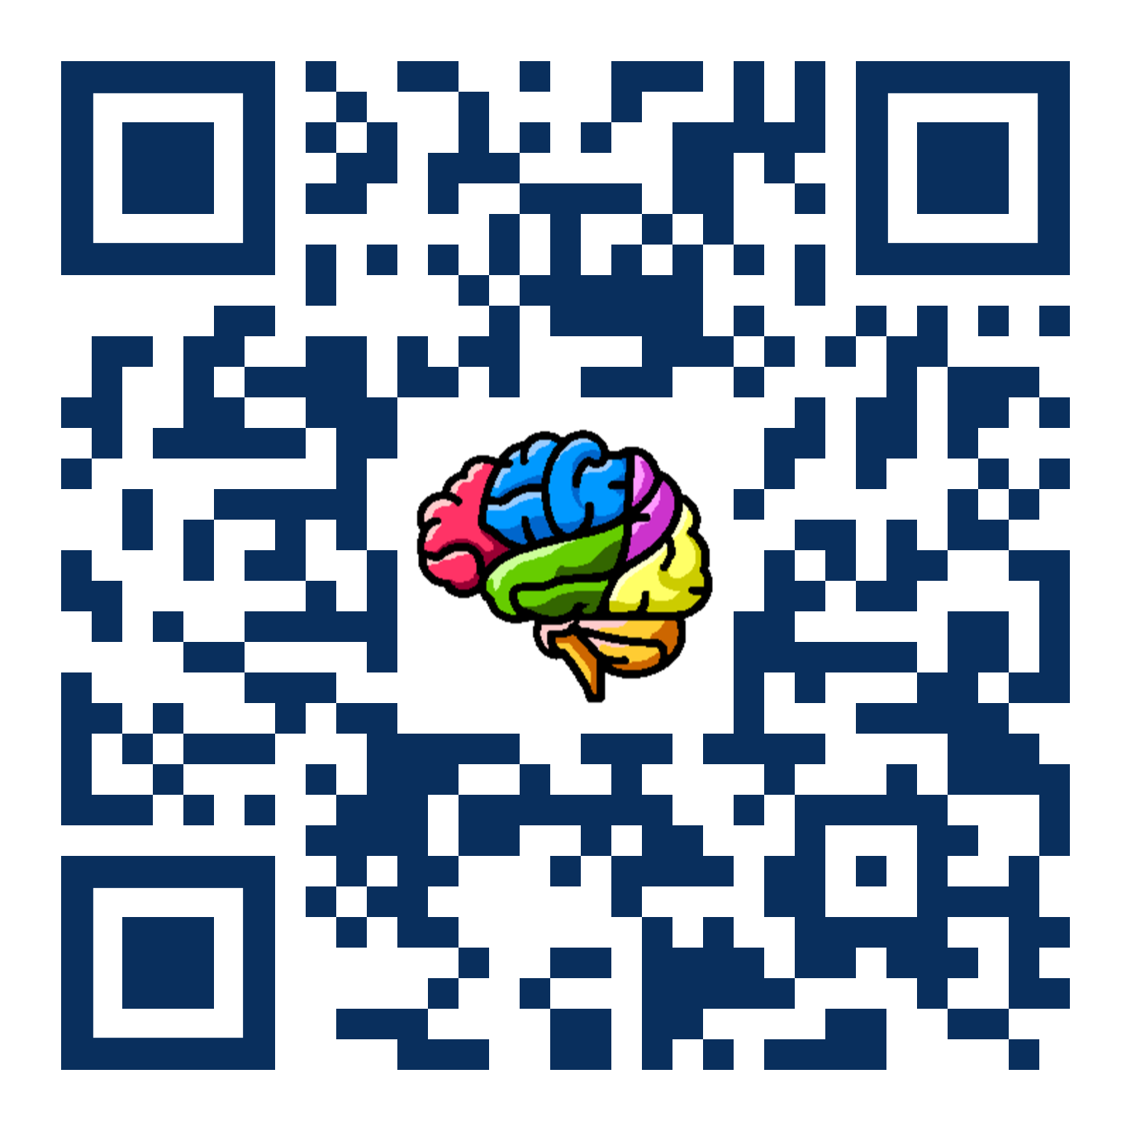


Thank you!
@NiChart_AIBIL
CBICA/NiChart_Project
Grants - Support
The Neuroimaging Brain Chart Software Suite
1U24NS130411-01
National Institutes of Health / National Institute of Neurological Disorders and Stroke
Notes:
Thank you for your attention. I look forward to any questions you may have.

